Slide 1

Nascent>>>
Project Name: Access@anywhere
Which is to find way people can get to visit their working environment.
Team member :
Li Shi(SH Telecom Researching Center)
Liao Wenzhao, Xin Sen, Yejiaojiao (SH Telecom Datacenter Dept.)
Zhang Xianli (Citycloud.com)

Slide 2


Work where U are
Cloud
VPC
Aloha
Please meet the time of moving.

Slide 3
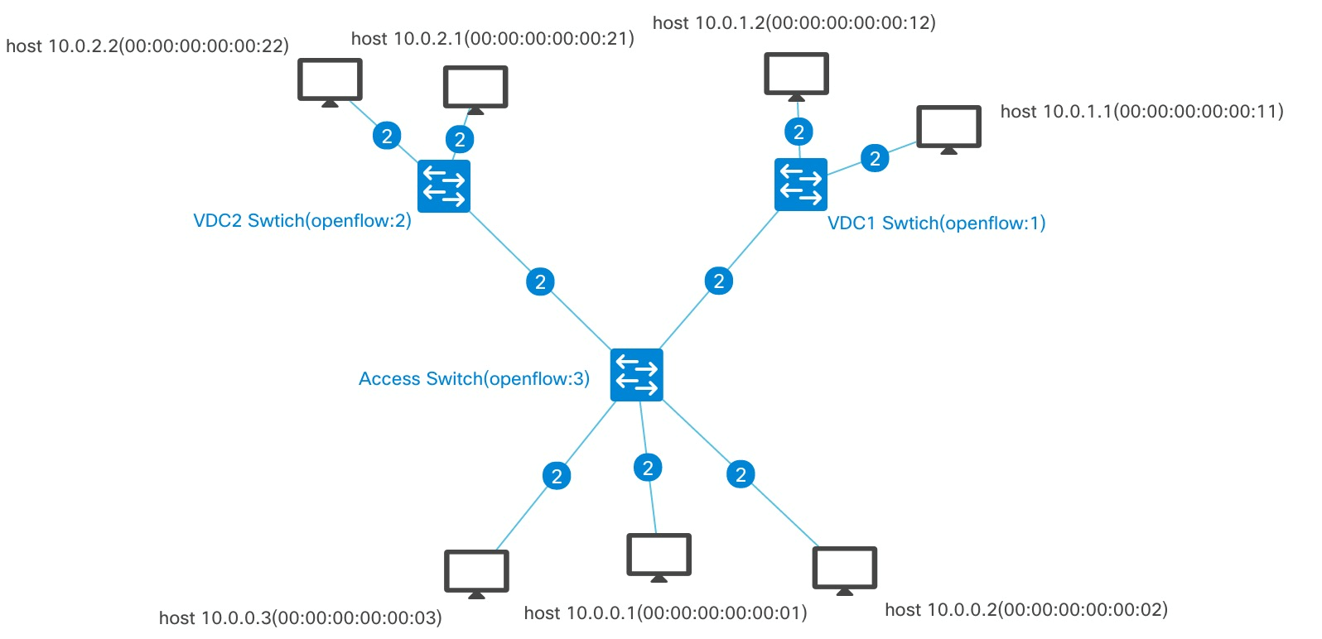

Part 2: Architecture
VPC1
VPC1
Registration portal
Topolgy
Controller(ODL) invoke molule
Rest API
Access Layer
Openflow
SW(VPC1)
SW(VPC2）
SW(access)
hostA
hostC
MAC1
MAC3
hostB
hostD
MAC2
miniet

Slide 4
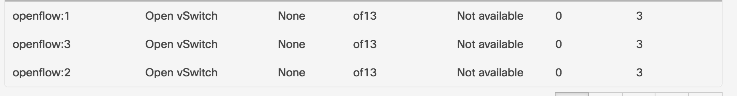
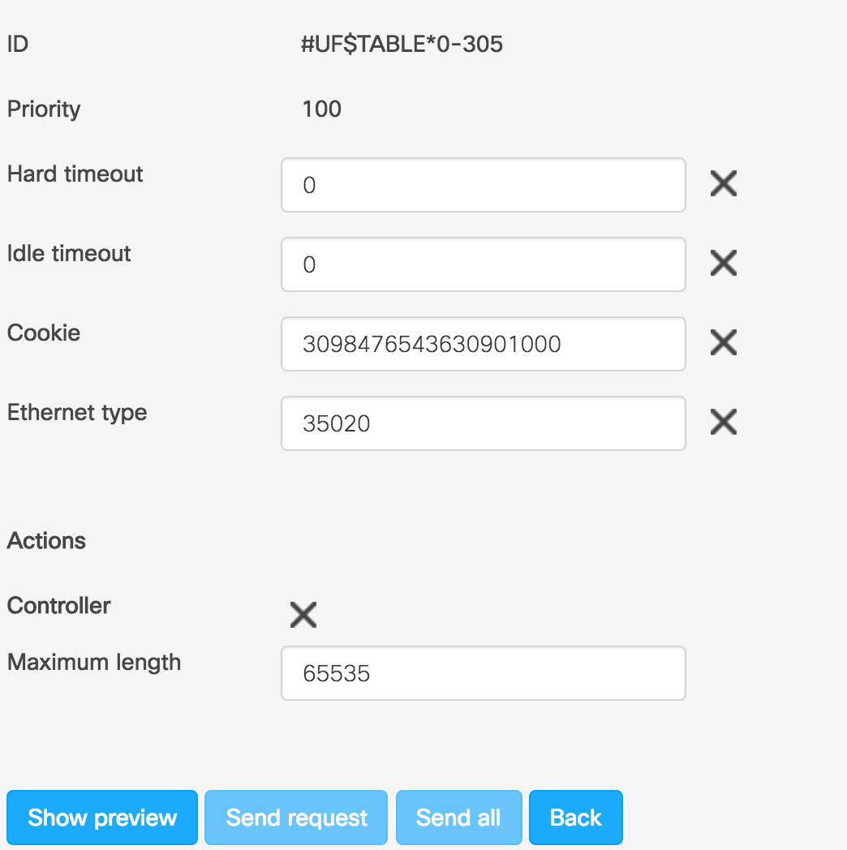
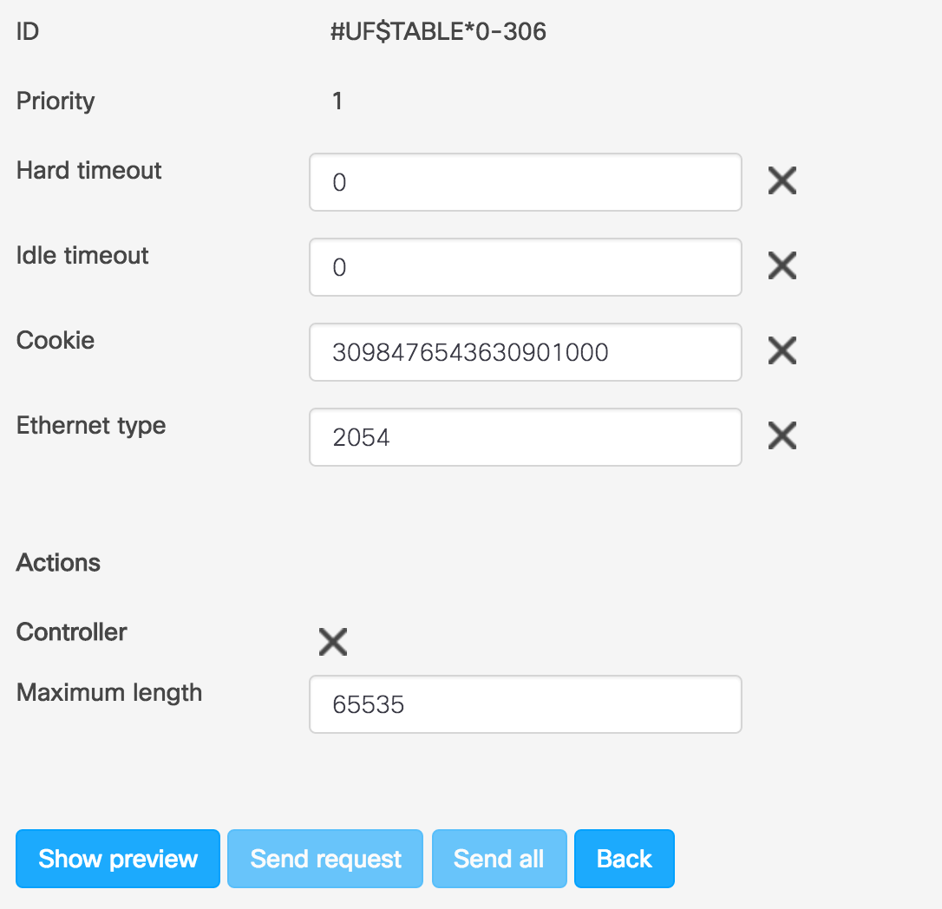
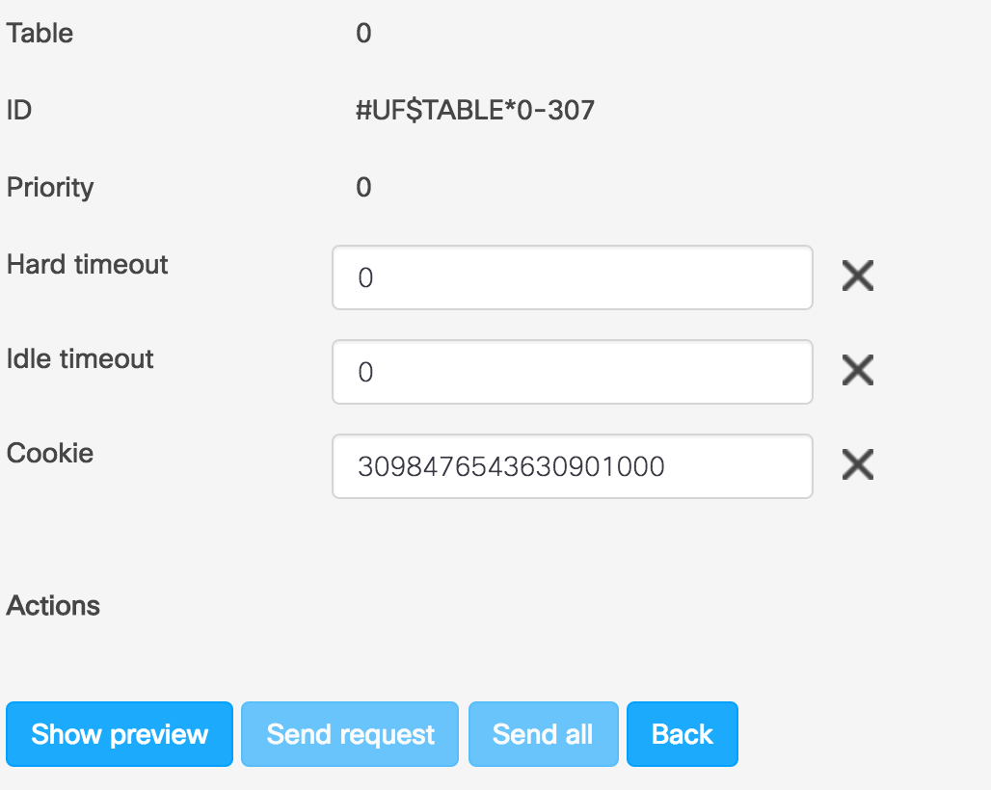
Part 3: Topology
Everything OFSW will be pushed 3 flow tables from Controller when booted.
Forming the topology by forwarding LLDP packets to Controller
MAC-port finding by forwarding ARP to Controller
LLDP &ARP flow table will be changed by cookie flow chart.

Slide 5
Part 3: Registration Portal
Registration portal is designed for user to select a MAC to use, after which, controller will set in-bound rules and out-bound rules:
Access switch
Match | Action
MAC | Out port | outbound
port | port | inbound

Slide 6
Technology used
Bootstrap、NextUI
Web Framework：Flask
Jinja2: model enginee
ORM：SQLAlchemy
DB:SQLite
opendaylight-inventory:nodes
network-topology:network-topology

Slide 7
Part 4: Share your status
Status:DEMO
Use case:
1)Jojo wants to link to her office, so she visits portal to register. By choosing the MAC she is to use, she can now enjoy access to the branch office fast.
2)And meanwhile, Chuck, wants to visit his office.
3)Jojo leaves, and she checks out.

Slide 8





What’s next>>>
netconf/restconf
netconf/restconf
netconf/restconf
openflow
VXLAN Overlay
vlan --> VNI

